Slide 1
Stanford ME469: Final Project Suggestion
Stefan P. Domino
Computational Thermal and Fluid Mechanics
Sandia National Laboratories SAND2018-4536 PE

Slide 2
High Performance Computing for CFD: Outline
Flow past rotating shapes
Hula Hoop
Your Choice?
Numerical Investigations
Physics Investigation
May required meshing skill…
Proposed problem provided to us by the end of this week…

Slide 3
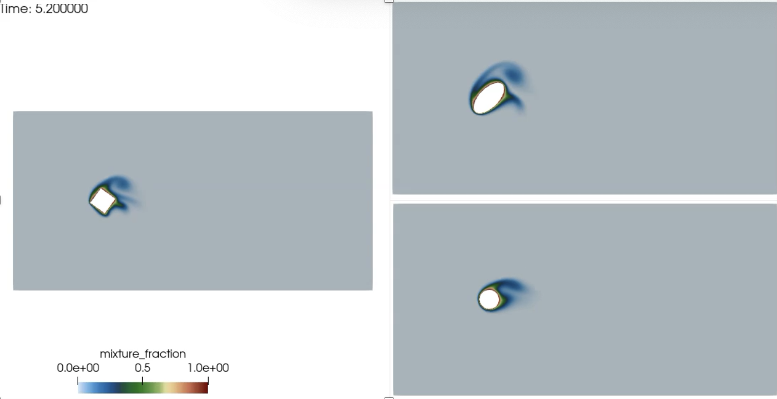
Flow Past Shapes: Nalu/examples/shape
Similar in concept to the midterm; drag and lift, now with a rotating object
Hybrid CVFEM/DG for sliding mesh interface, Domino, JCP, 2018
Two mesh resolutions provided, R0 and R1

Slide 4
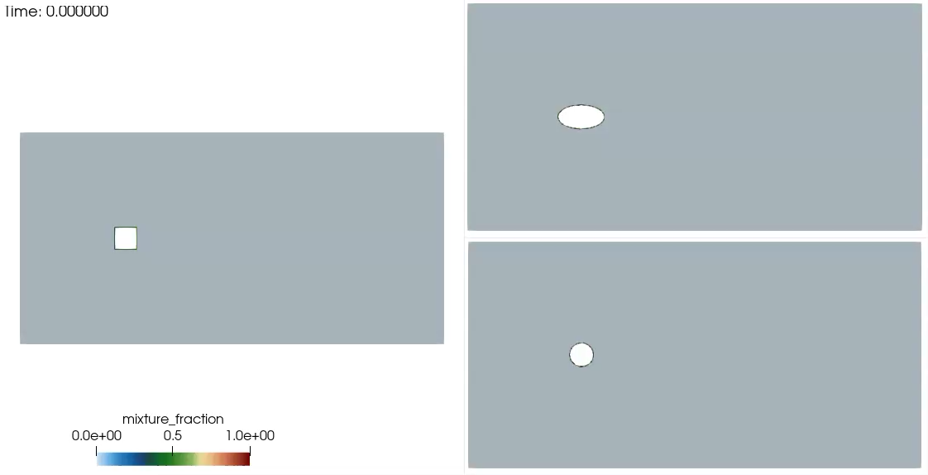
Flow Past Shapes: Nalu/examples/shape
Similar in concept to the midterm; drag and lift, now with a rotating object
Hybrid CVFEM/DG for sliding mesh interface, Domino, JCP, 2018
Two mesh resolutions provided, R0 and R1

Slide 5
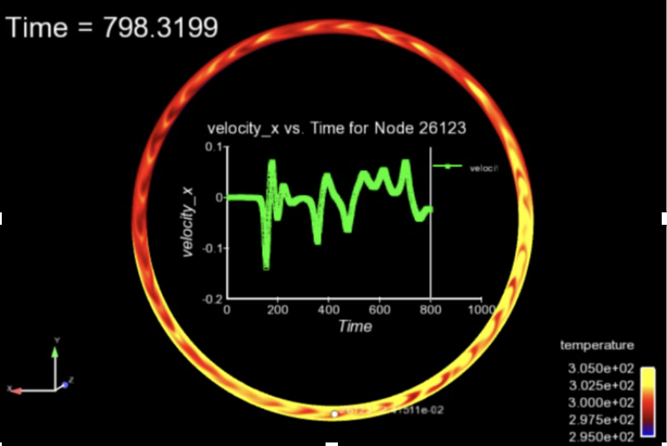
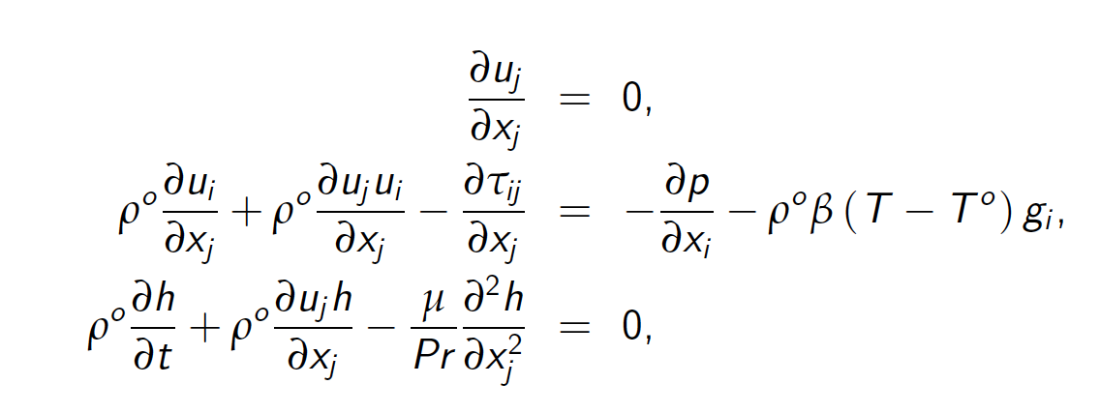
Hula hoop: Nalu/examples/hula
Based on the original Lorenz Attractor
Boussinesq properties (density and viscosity are constant, buoyancy provided based on the coefficient of thermal expansion, β)
R0 and R1 mesh provided
Louisos et al., 2013 “Chaotic flow in a 2D natural convection loop with heat flux boundaries”
Hydrostatic pressure represented in modified buoyancy source term

Slide 6
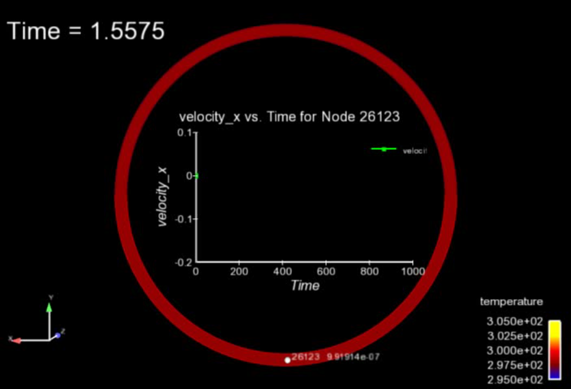
Hula hoop: Nalu/examples/hula
Based on the original Lorenz Attractor
Boussinesq properties (density and viscosity are constant, buoyancy provided based on the coefficient of thermal expansion, β)
R0 and R1 mesh provided
Louisos et al., 2013 “Chaotic flow in a 2D natural convection loop with heat flux boundaries”
Hydrostatic pressure represented in modified buoyancy source term

Slide 7
Your Choice
Numerical “deep dive” – May require building Nalu, which we could help you accomplish
First-order in time vs second-order in time
Limiter types, effects
Volume of Fluid dam break investigation
Any of the labs can be explored further…
Let us know!

Slide 8
Conclusions: Final Project
Rotating shapes that introduce the sliding mesh construct (read the paper!)
Hula hoop ramps up Lorenz’s system (read the paper!)
Full flexibility over what you study!
Required pre-approval (this week)
Enjoy and have fun

